Slide 1
Workshop
Moving from within – Contact Improvisation and Fascia

Slide 2
Introduction into Fascia:
Generell Theory / Video Part 1 Gimberteau (15min)
Fascia as a Sensoric Organ:
Theory / Video Example from Robert Schleip (15min)
Warm Up (20min)
Bodywork in Movement (45min)
Pause (15min)

Slide 3
Time for Questions(5min)
Fascia as a Force Transmitting Structur: Tensegrity Modell / Video Part 2 Gimberteau (15min)

Slide 4
Exercises for stabilisation (30min)
Taking weight / Giving weight (30min)
Improvisation (25min)
Questions / Feedback / Conclusions (15min)

Slide 5
Introduction into Fascia:
Generell Theory / Video Part 1 Gimberteau 15min

Slide 6
Explaining the notion of the fascial net as a three dimensional network in the human body.
A network which has different functions and properties:
-it´s a sensoric organ (embedded nerve cells); this nerve endings conected to our brain give us specific informations on
-fascia is a mechanical force transmitting structur, therefore it has different densities at different locations to transmitt force throughout the body and withstand it
-it´s a structure in which the lymphatic systems is inbeded in

Slide 7
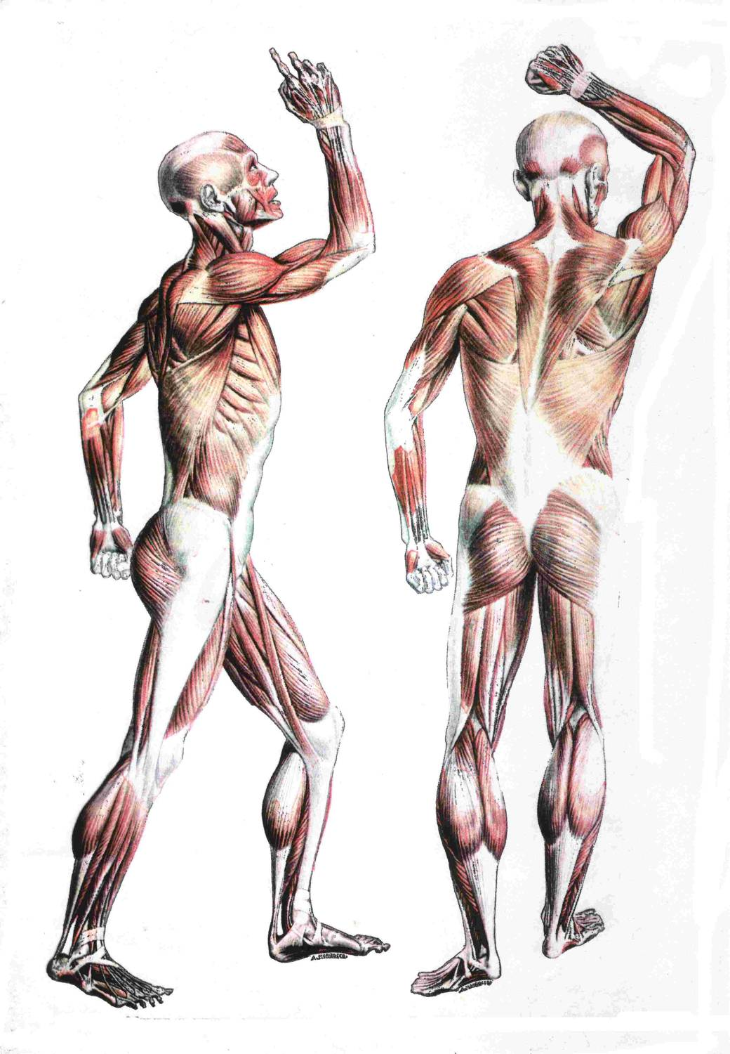

Slide 8
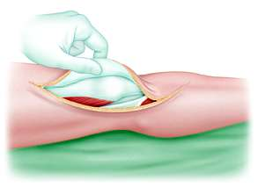
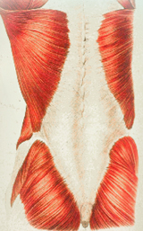

Slide 9
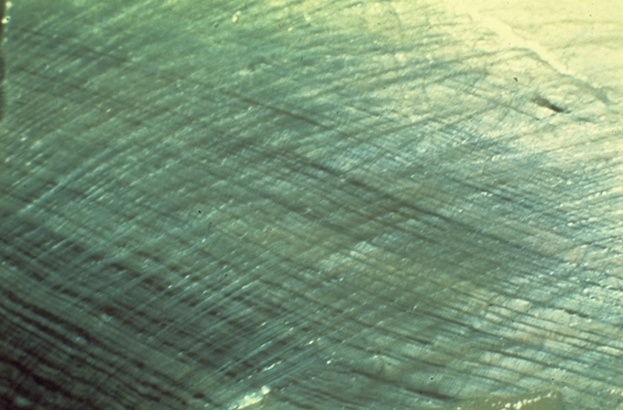
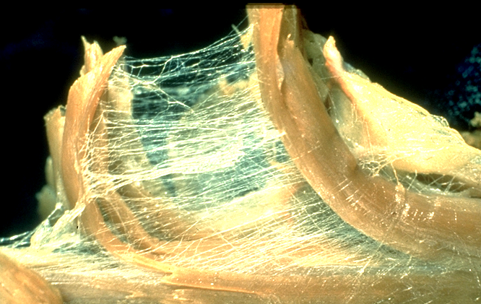

Slide 10
Fascia as a Sensoric Organ:
Theory / Video Example from Robert Schleip 15min

Slide 11
Warm Up 20min
Stimulation of the nerve endings by:
-Rolling your skin along the floor in aiming to have all your skin touched once and try to be fluid and light as possible
-starting to pull off more and more of your skin away from the floor until there is almost non on the floor
-Starting to put deliberatly a little more weight on different bodyparts towards the floor while moving
-place/fix a body part on the floor and then move away/around and towards it. Keep changing the fixed body part once in a while
-keep going on with what you do just add some shaking to it
-Improvise with all the four elements for a while finding smooth transitions

Slide 12
Bodywork in Movement 45min
Working in Group of three:
1 Person receiving / beeing passiv becoming gradually more
active during excersise preferable lying on there backs
2 Persons giver / explorer / manipulator
-Beginning to move the limps of the person, exploring ranges of
mobility in there joints
-Gradually finding ways of pulling and pushing on the limbs finding
possibillities to let that travel through the body while the givers try
to stay connected to each other
-start to sneak under the recievers body trying to lift them up from
the floor, find ways to have them completle of the floor, givers
build a new floor
-find a way of bringing the reciever bit by bit into a standing
position

Slide 13
Pause 15min

Slide 14
Time for questions 5min

Slide 15
Fascia as a Force Transmitting Structur: Tensegrity Modell / Video Part 2 Gimberteau 15min

Slide 16
Exercises for stabilisation
(Core activation) 30min
Working in pairs. Starting position on all fours
Left shoulder placed to the left shoulder of the partner
Starting to reach into another in exchange see if you can make your partner move
Change shoulders one in a wile
Start to push into each other see how you can be direct strong without beeing hard
Bring your partner into moving slowly throug space
Combining Reach and Push / Moving into other levels and planes while moving keep clarity

Slide 17
Taking weight
/
Giving weight 30min

Slide 18
Improvisation 25min
Free Improvisation using the refreshed and new knowledge
Starting out in new couples

Slide 19
Questions / Feedback/ Conclusions 15min
Concerning:
-the fascial web
-Own body experience
- On emotional state
-Anything you want to mention

